Slide 1

Mock Test 2
May 2022

Slide 2
return/single/corporate/couchette/buffet
We didn’t know when we’d go back so we bought a … ticket.
Their train was travelling by night, so they chose a … .
… traveller travels on business.

Slide 3
return/single/corporate/couchette/buffet
We didn’t know when we’d go back so we bought a single ticket.
Their train was travelling by night, so they chose a couchette .
Corporate traveller travels on business.

Slide 4
MAKE POLITE QUESTIONS
How long is the flight to Beijing?
Have you ever travelled by ship?
How much does a ticket to Barcelona cost?

Slide 5
Can you tell me…
how long the flight to Beijing is
if you have ever travelled by ship
how much a ticket to Barcelona costs

Slide 6
P… is where you get on and off a train at the station.
I… is a list of goods or services to be paid.
V… parks a car for guests.

Slide 7
Platform is where you get on and off a train at the station.
Invoice is a list of goods or services to be paid.
Valet parks a car for guests.

Slide 8
past tense or present perfect
… you ever … Indian food? (try)
His train … yesterday evening (leave)
She … every summer in Greece since 2005 (spend)

Slide 9
past tense or present perfect
Have you ever tried Indian food?
His train left yesterday evening.
She has spent every summer in Greece since 2005.

Slide 10
conveyor shore coast client safety excursion history document belts
At airports, baggage is taken and brought on …
During … cruise passengers can go sightseeing, shopping and dining.
Travel agents keep … so they know the needs and preferences for future bookings.

Slide 11
conveyor shore coast client safety excursions history document belts
At airports, baggage is taken and brought on conveyor belts.
During shore excursions cruies passengers can go sightseeing, shopping and dining.
Travel agents keep client history so they know the needs and preferences for future bookings.

Slide 12
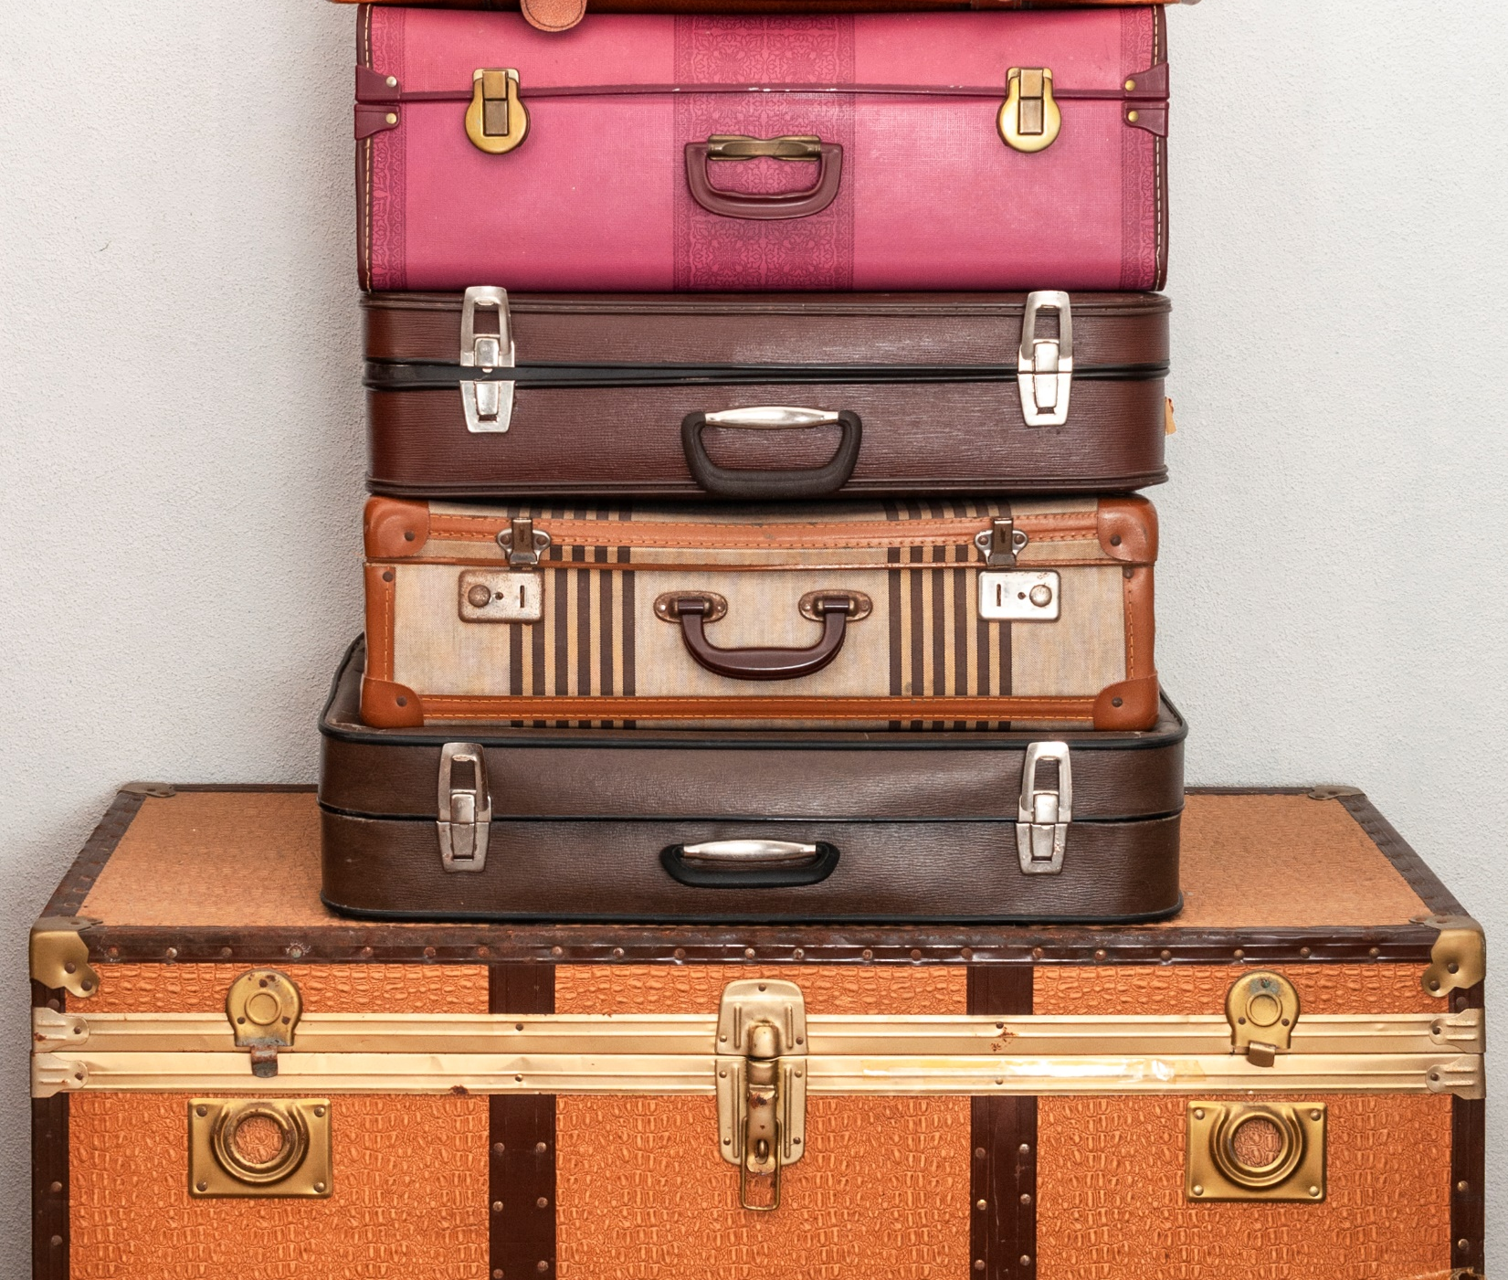
Bonus
Give three examples of baggage on flight
Give three examples of flight class

Slide 13

Bonus
Explain the advantages and disadvantages of travelling by car.
Explain why train or plane is better for short haul distances.

Slide 14
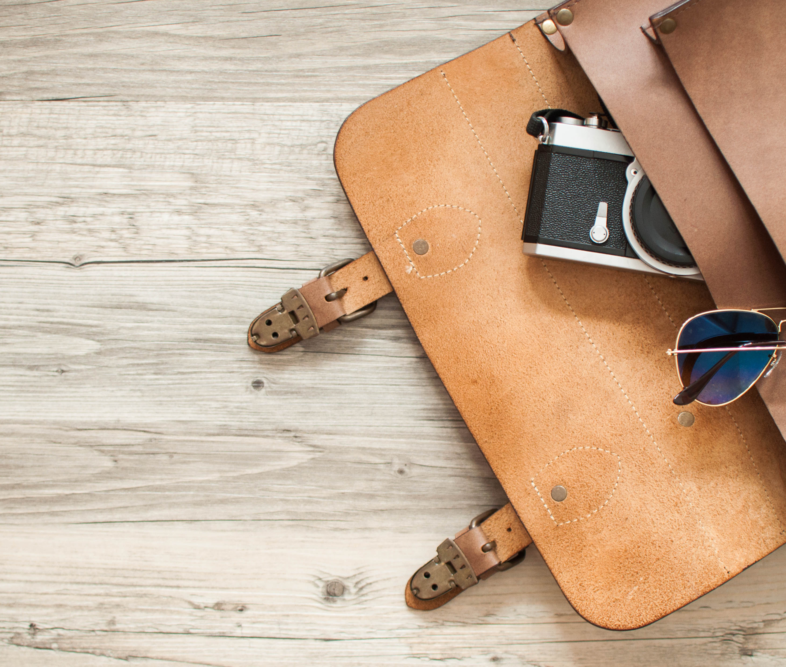
Bonus
Name three duties of a travel agent
Name three duties of a tour operator

Slide 15

Good Luck!

